Slide 1
MTAT.03.231
Business Process Management (BPM)
Lecture 3: Advanced Process Modeling
Marlon Dumas
marlon.dumas ät ut . ee

Slide 2


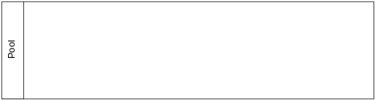



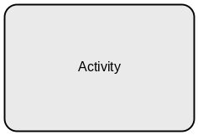

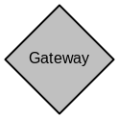
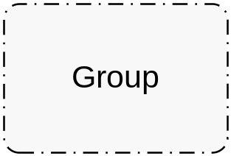

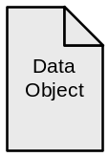
BPMN Main Elements - Recap
Connections
Swimlanes
Flow Objects
Artifacts

Slide 3
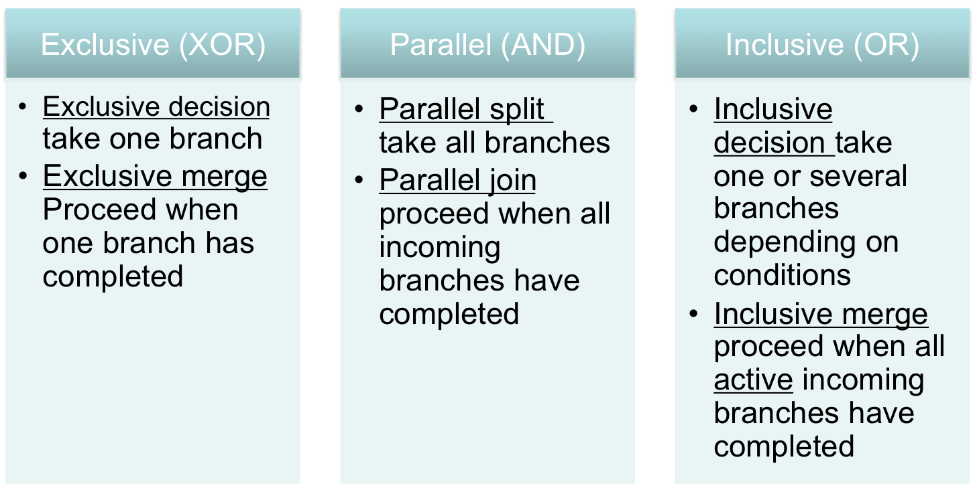
BPMN Gateways

Slide 4
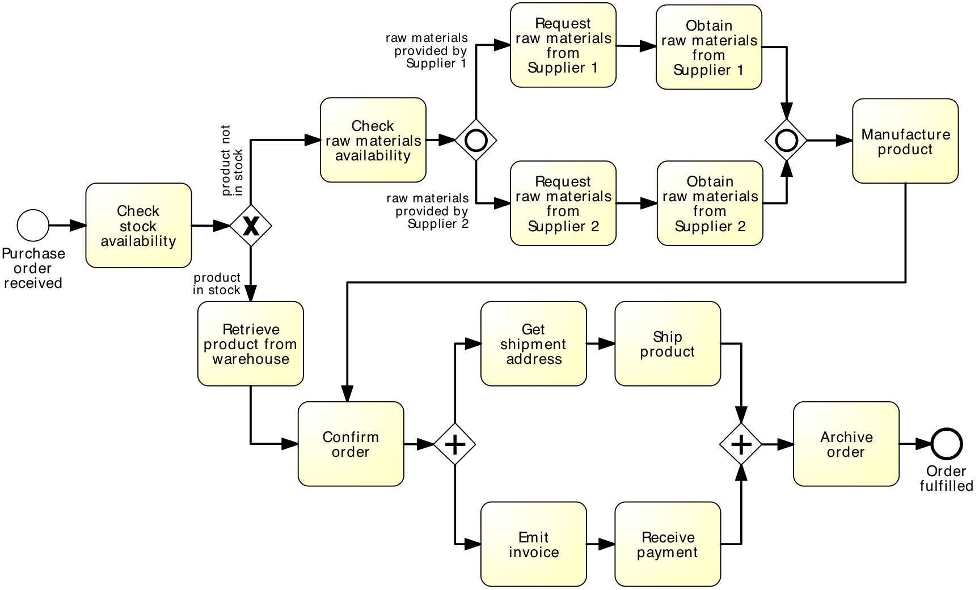
Anything wrong with this model?

Slide 5
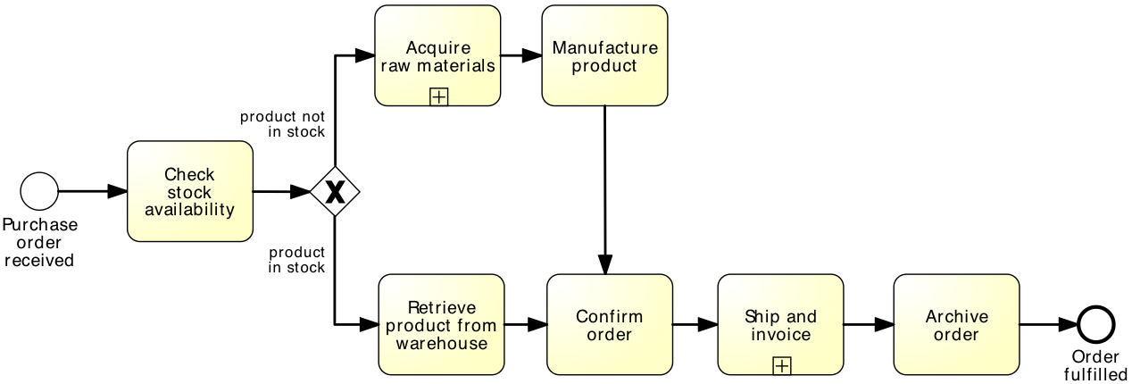
Is this better?

Slide 6
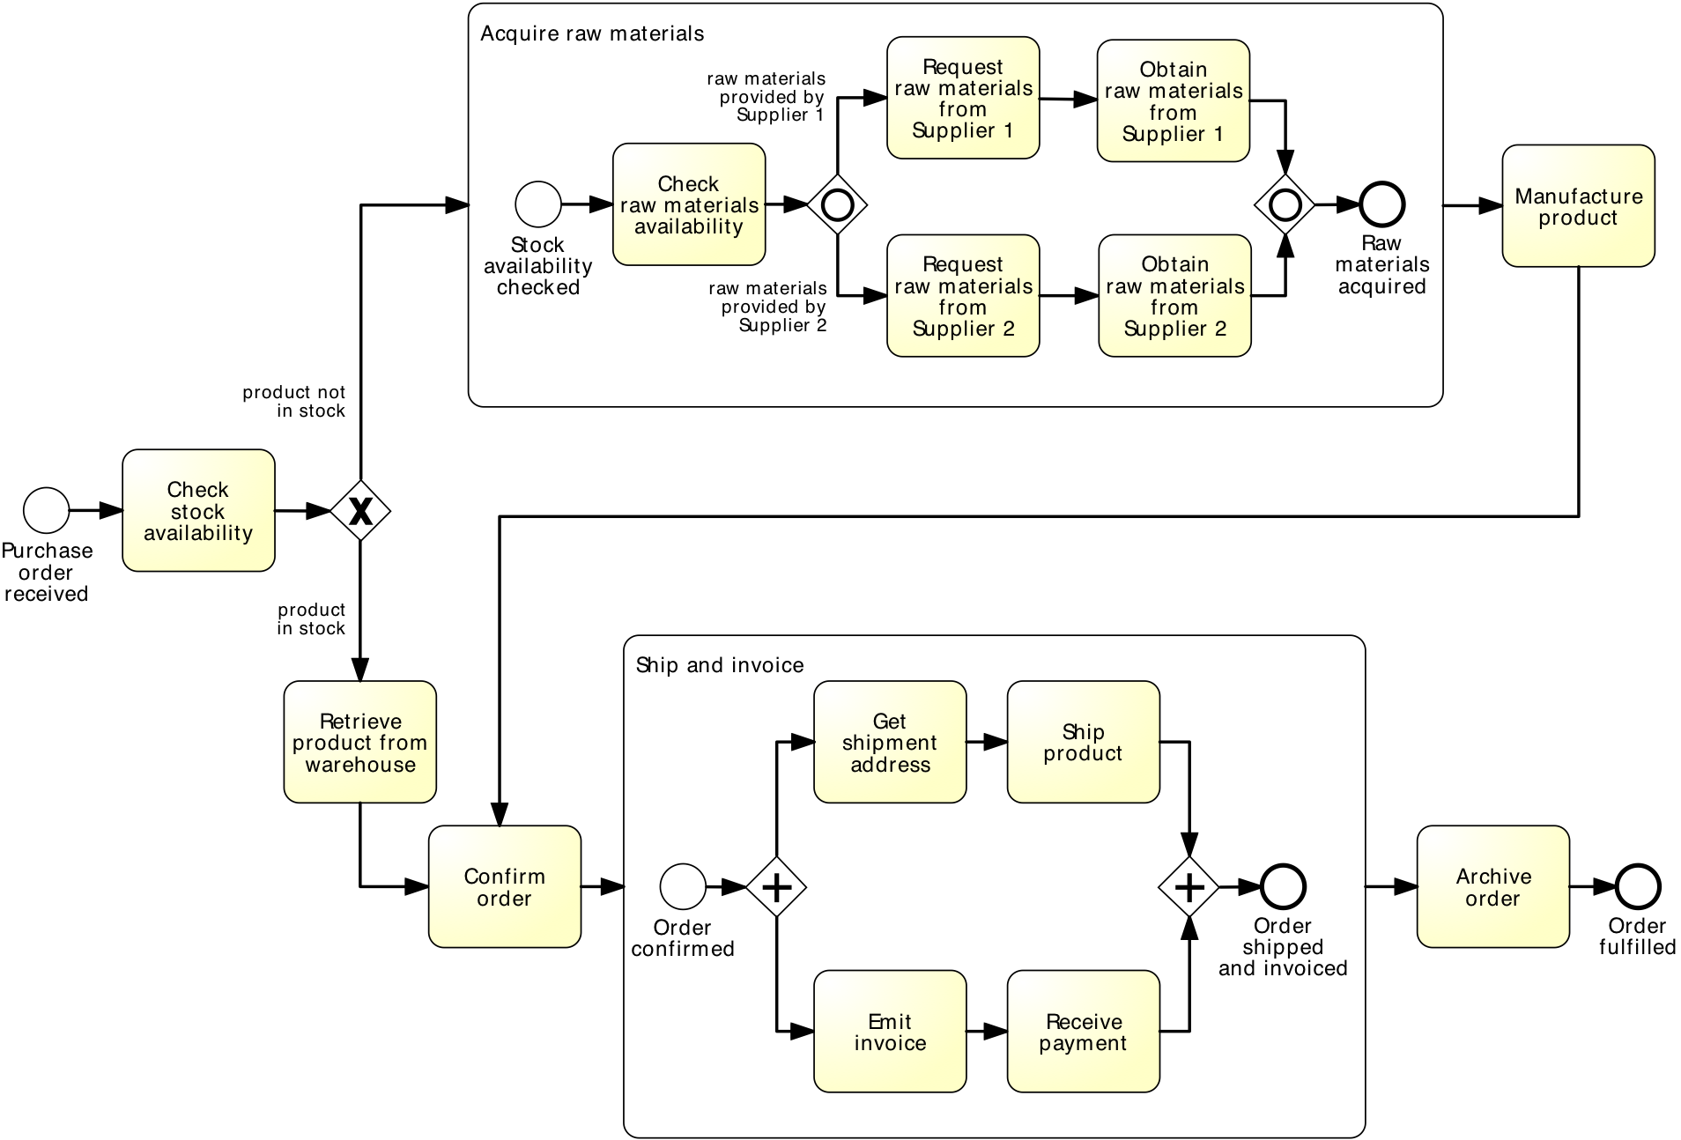
Expanded…

Slide 7
Sub-processes
An activity in a process can “invoke” a separate (sub-)process
Use this feature to:
  Break down large models into smaller ones, making them easier to understand and maintain
    → process hierarchies
  Share common fragments across multiple processes
    → shared subprocesses
  Identify parts of a process that should be:
    repeated
    executed multiple times in parallel
    cancelled

Slide 8
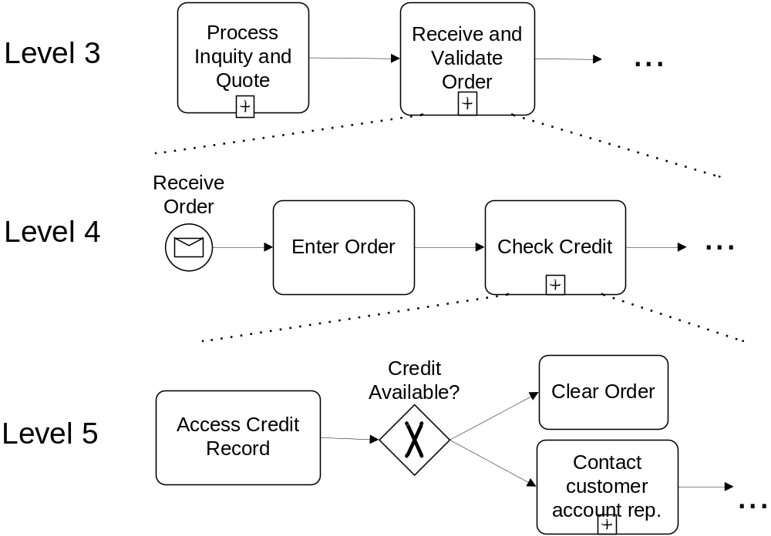
Process hierarchies
Fragment of the SCOR model

Slide 9
Modeling Guideline
Start with a value chain
Good practice is that the top-level process should be simple (no gateways) and should show the main phases of the process
  Each phase then becomes a sub-process
  This is sometimes called a “value chain”

Slide 10
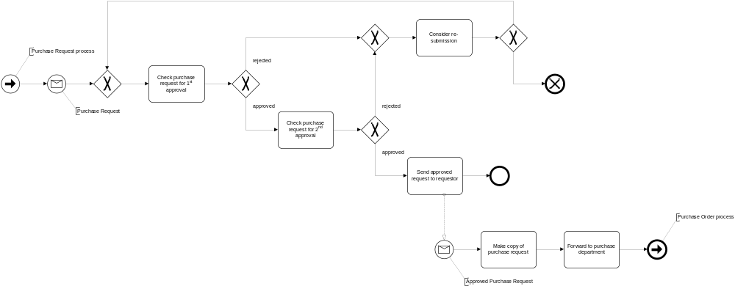
Showing the value chain with sub-processes

Slide 11
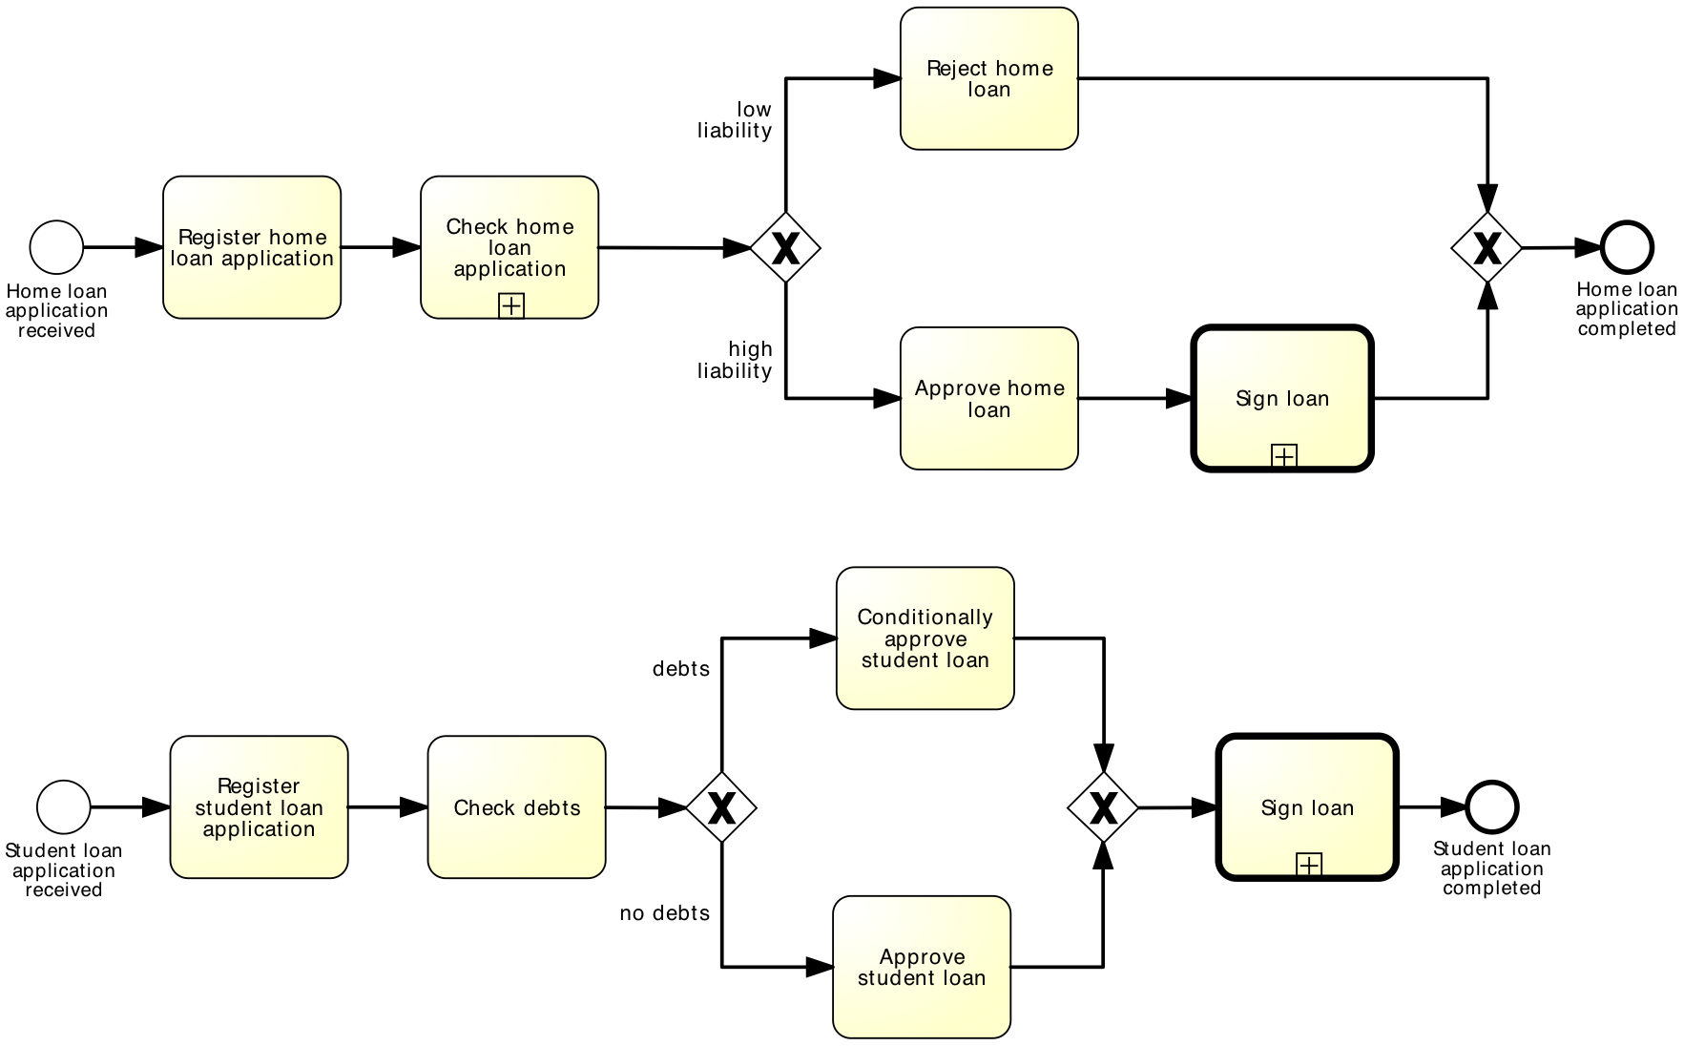
Shared sub-process

Slide 12
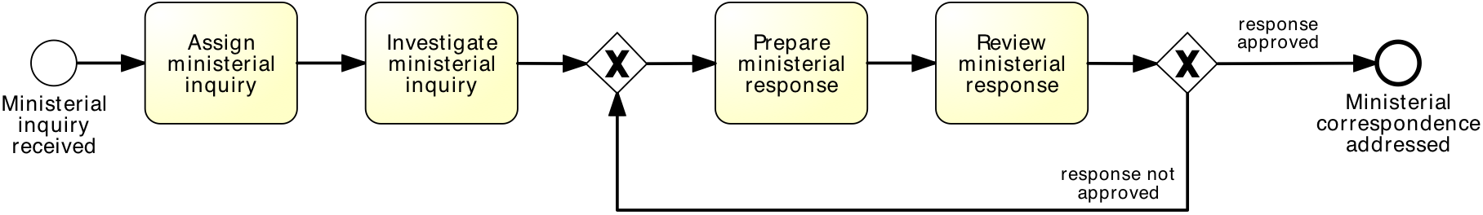
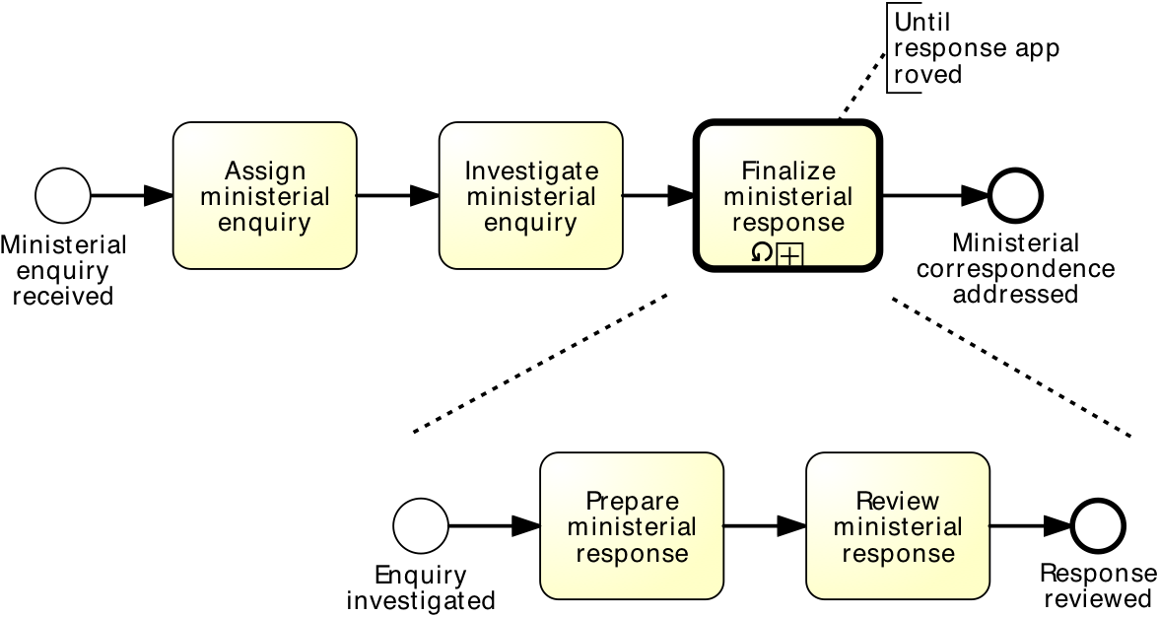
Sub-processes and loop marker
equivalent to:

Slide 13
Exercise
After a claim is registered, it is examined by a claims officer. The claims officer then writes a “settlement recommendation”. This recommendation is checked by a senior claims officer who may mark the claim as “OK” or “Not OK”. If the claim is marked as “Not OK”, it is sent back to the claims officer and the examination is repeated. If the claim is marked as “OK”, the claims officer notifies the settlement to the customer.

Slide 14
Multiple instance marker
“Multiple instance” marker ~ “parallel repetition” of an activity/sub-process
Useful when the same activity should be executed for multiple entities or data items, e.g.
  Request quotes from multiple suppliers
  Check the availability for each line item in an order separately
  Send and gather questionnaires for multiple witnesses in the context of an insurance claim

Slide 15
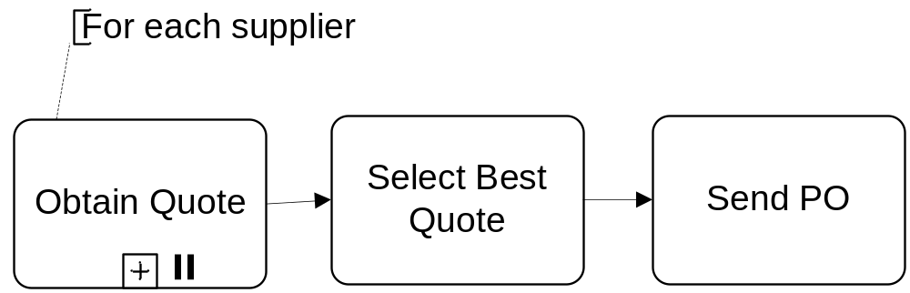
Multiple instance activity - example
Notes:
http://www.workflowpatterns.com/patterns/control/multiple_instance/wcp14_animation.php

Slide 16
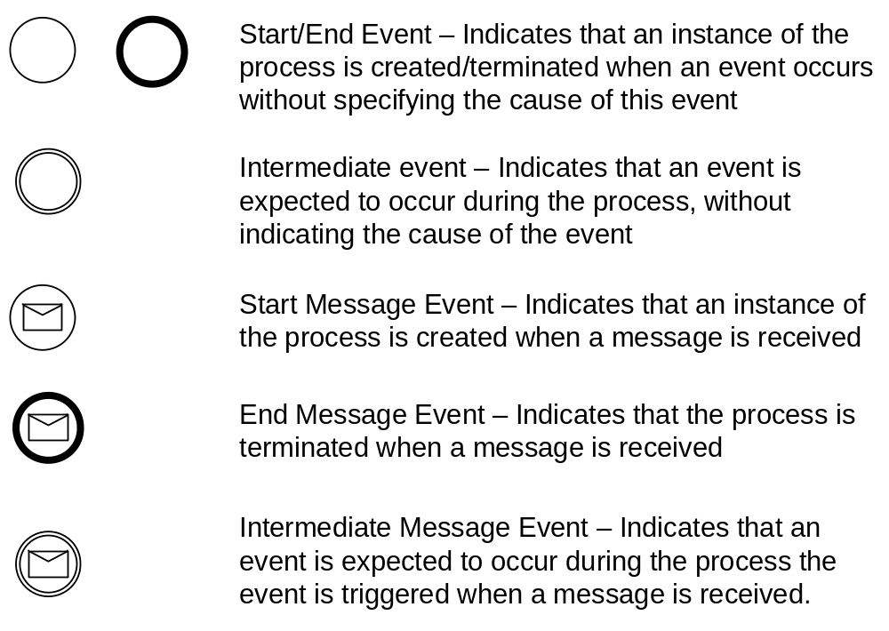
Event types

Slide 17
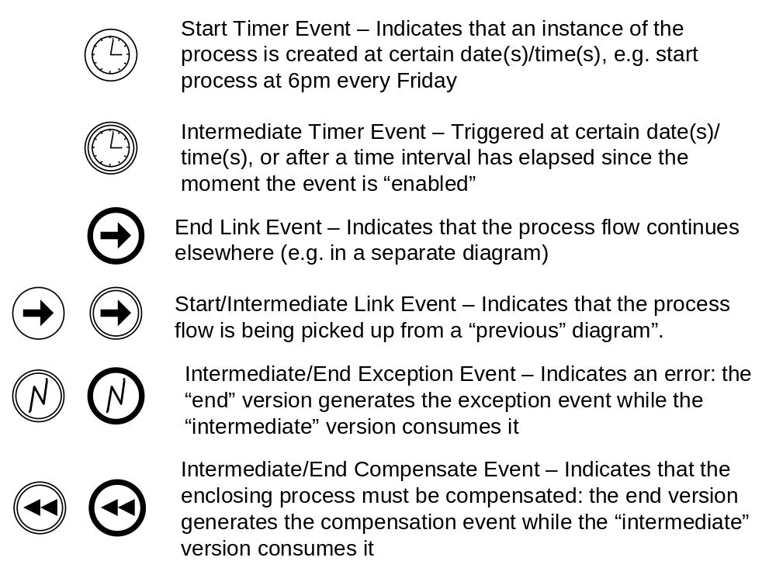
Event types (cont.)

Slide 18
And more...
Condition events
Escalation events
Signal events, …
Check the BPMN poster:
  http://www.bpmb.de/images/BPMN2_0_Poster_EN.pdf

Slide 19
Modelling with events - Example
A PO handling process starts when a PO is received. The PO is first registered. If the current date is not a working day, the process waits until the following working day before proceeding.
Otherwise, an availability check is performed and a “PO response” is sent back to the customer.
Anytime during the process, the customer may send a “PO change request”. When such a request is received, it is just registered, without further action.

Slide 20
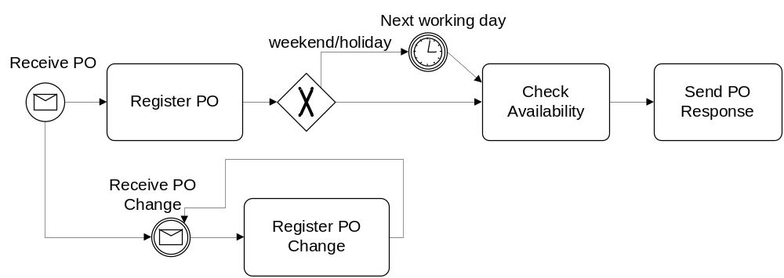
Modelling with events - Example

Slide 21
Data-based vs. event-based decision
In an XOR-split gateway, one branch is chosen based on expressions evaluated over available data
  Choice is made immediately when the gateway is reached
Sometimes, the choice must be delayed until something happens
  Choice is based on a “race between events”
BPMN distinguishes between:
  Exclusive decision gateway (XOR-split)
  Event-based decision gateway
Notes:
See “exclusive choice” pattern: http://www.workflowpatterns.com/patterns/control/basic/wcp4_animation.php
See “deferred choice” pattern: http://www.workflowpatterns.com/patterns/control/state/wcp16.php

Slide 22
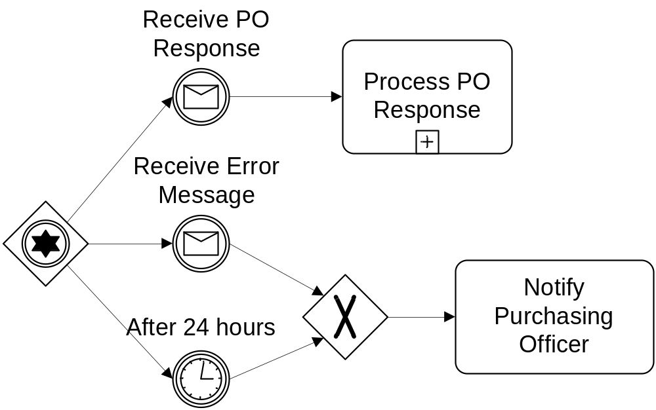
Event-driven Decision – Example
Notes:
After a purchase order is sent, a customer can receive either a “PO Response” or an error message. It may happen that no response is received at all. If no response is received after 24 hours or if an error message is received, the purchasing officer should be notified. Otherwise, the PO Response is processed normally.

Slide 23
Exercise
In the context of a claim handling process, it is sometimes necessary to send a questionnaire to the claimant to gather additional information. The claimant is expected to return the questionnaire within five days. If no response is received after five days, a reminder is sent to the claimant. If after another five days there is still no response, another reminder is sent and so on until the completed questionnaire is received.

Slide 24
Boundary events
Sometimes during a sub-process execution, some event may occur that needs some action…
Such events are placed at the boundaries of the sub-process (boundary events)
Two flavors:
  Interrupting boundary events
  Non-interrupting boundary events

Slide 25
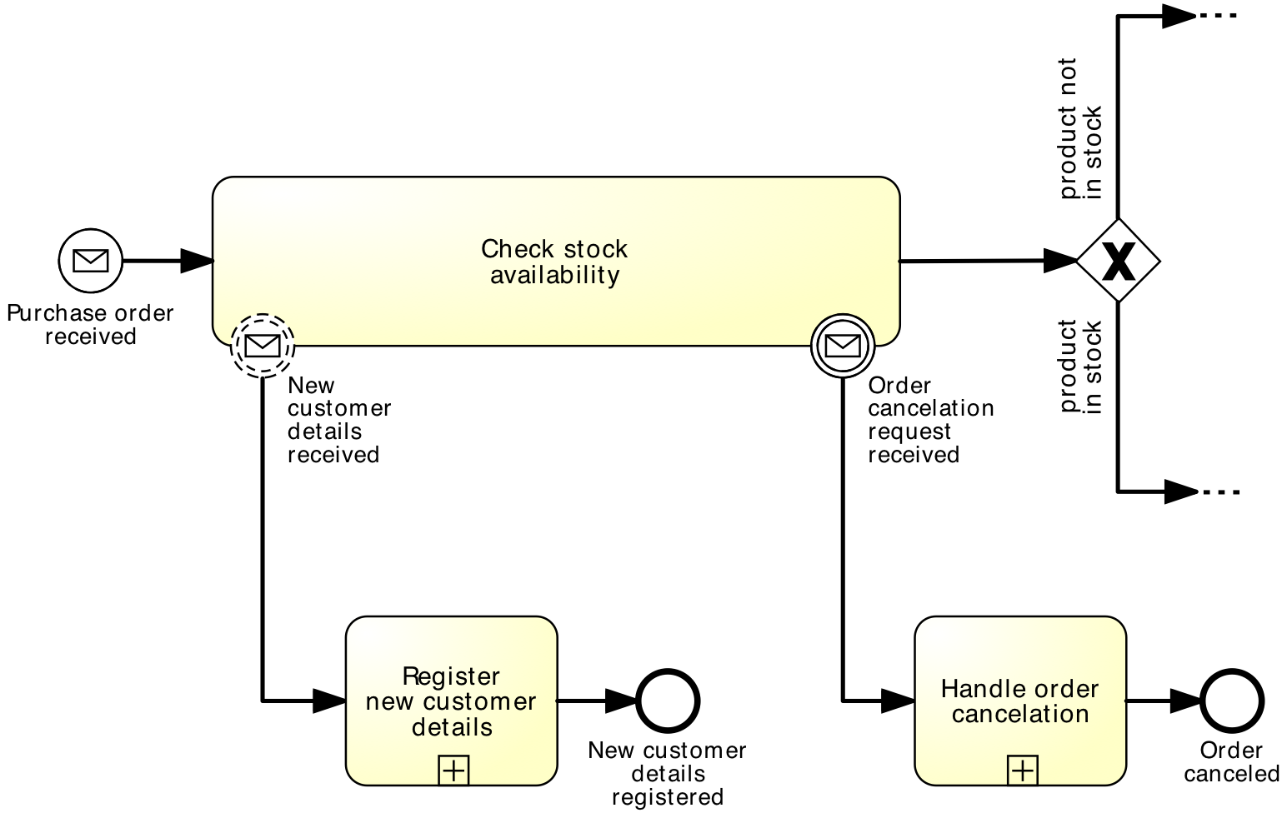
Boundary Events – Example

Slide 26
Event sub-processes
An event sub-process are processes attached to a parent process, that are triggered when an event happens
Alternative to putting a boundary non-interrupting event around the parent process

Slide 27
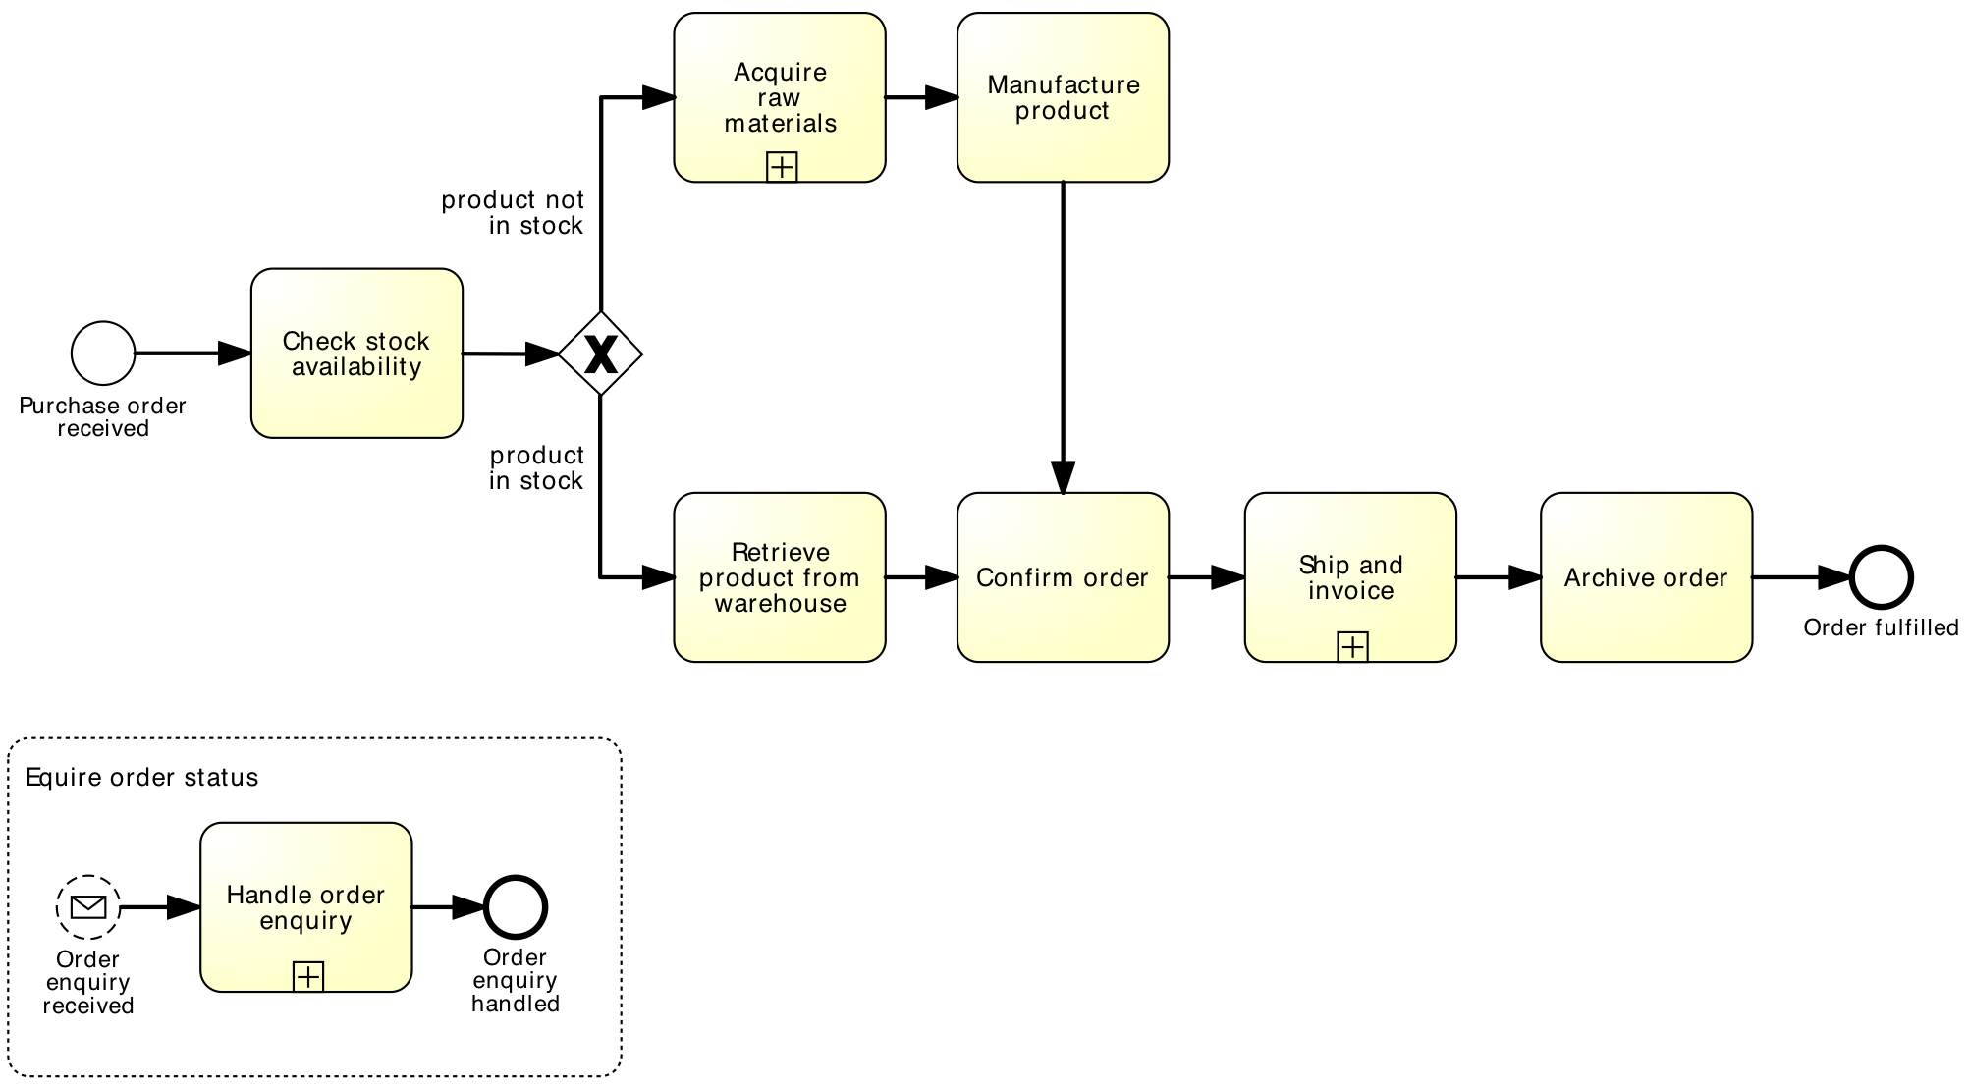
Event sub-processes – Example

Slide 28
Exception handling (error events)
Exceptions are events that deviate a process from its “normal” course
Handling exceptions often involves stopping a sub-process and performing a special activity
Achieved using two event nodes:
  An “end error event” that stops the enclosing subprocess execution
  An “intermediate error event” attached to the enclosing subprocess – this is where the process execution will continue after the error

Slide 29
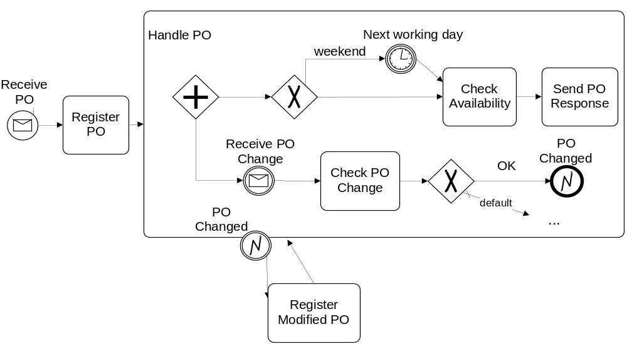

Error events – Example
Notes:
Consider the previous “PO Change Request” example with the following variation: When a PO Change Request is received, it is first checked to determined if it can be accepted. If it is accepted, any processing related to the PO must be stopped. The PO change request is then registered. Thereafter, the process proceeds as it would after a “normal” PO is registered.

Slide 30
Exercise
When a claim is received, it is registered. After registration, the claim is classified leading to two possible outcomes: simple or complex. If the claim is simple, the policy is checked. For complex claims, both the policy and the damage are checked independently.
A possible outcome of the policy check is that the insurance is invalid. In this case, any processing is cancelled and a letter is sent to the customer. In the case of a complex claim, this implies that the damage checking is cancelled if it has not yet been completed.

Slide 31
Summary
In this lecture we have learned about:
  BPMN sub-processes
  Sub-process markers: loop and multiple-instance
  Events: timer, message and error events
  Event-based choice gateway
  Boundary events (interrupting and non-interrupting)

Slide 32
And once I’ve got a model, what’s next?
Some process analysis techniques:
  Added-Value Analysis
  Root-Cause Analysis
  Flow Analysis
  Queuing Analysis
  Process Simulation

